Slide 1

Welcome to Longford Church of England Primary School!
Meet New Parents – Longford C of E Primary School

Slide 2
Today’s Meeting
To help your child make the best possible start to school.
To help you to understand the curriculum that your child will be covering in the reception class.
To understand how we teach in order to cover the requirements of the curriculum.
To identify the key ways in which you can help your child at home and in school.
Notes:
Recent research evidence demonstrates that...
Consistency across home and school promotes achievements for young children
Family involvement in children’s learning has an influence on children’s happiness, achievement and learning
Parent/school partnership can improve children’s motivation, behaviour and self-esteem and language development
We have been to visit all of the children at pre school over the last couple weeks- great to see them in a familiar environment

Slide 3

Welcome to Our School!
We are delighted to welcome you to Longford Church of England Primary School! Our school is a friendly place where we learn and grow together. We are proud to be a church school and part of the Pickwick Trust, making our community even stronger!
Longford Church of England Primary School

Slide 4
Our School Values
At Longford, we believe in kindness, respect, and friendship. We support each other and create a safe place to learn. Our values help us become good friends and caring members of our community. Together, we can achieve great things and make our school the best!

Slide 5
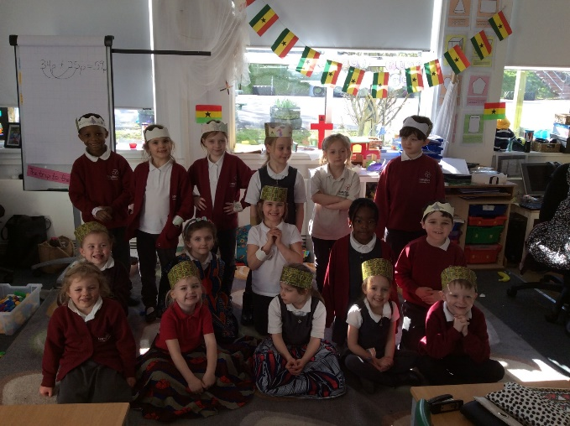
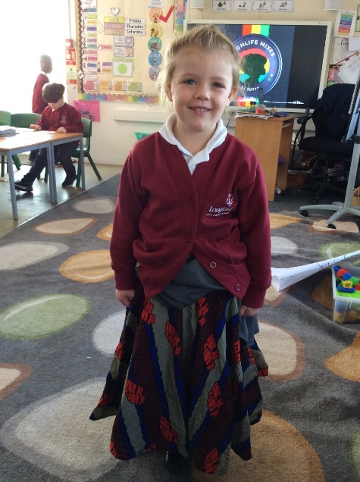
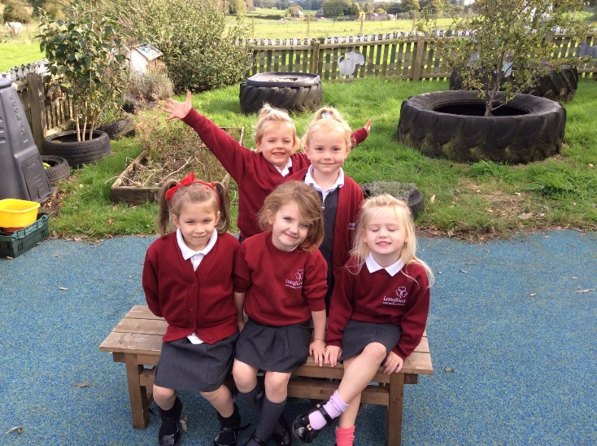
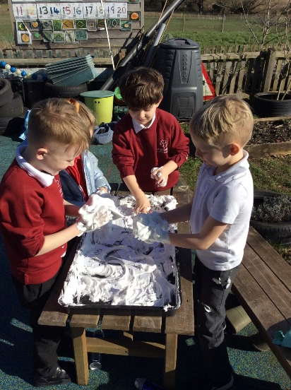
About Our Class
In Explorers Class, we have children from Year R, Year 1, and Year 2 all together. This means we learn a lot from each other! There are 20 of us in total, and it's a fun way to make new friends and share experiences as we learn together! Our classroom is a place of fun and learning!

Slide 6
What is the Early Years Foundation Stage?
The Early Years Foundation Stage (EYFS) is the stage of education for children from birth to the end of the Reception year.
It is based on the recognition that children learn best through play and active learning.
Notes:
Already using the curriculum at Pre School
We build on it during the Reception year

Slide 7
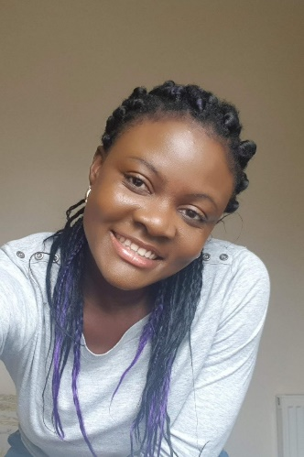
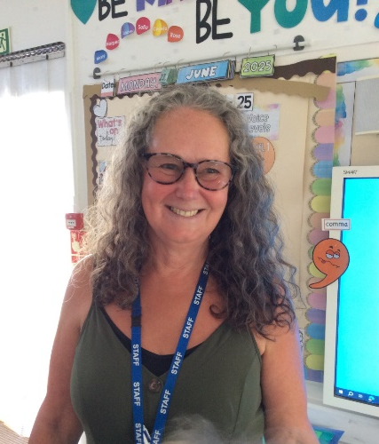
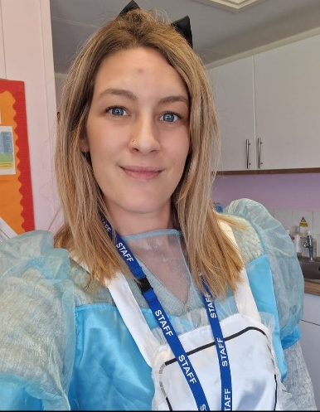
Reception Staff
Mrs Osei-Konadu
EYFS Class Teacher
Mrs Young
Mrs Mills
Notes:
2 classes- great opportunity for the children- smaller classes (at least to begin with!) more space/ adults to support learning
The classes will work very much together so the children receive the same experiences/ learning opportunities.

Slide 8
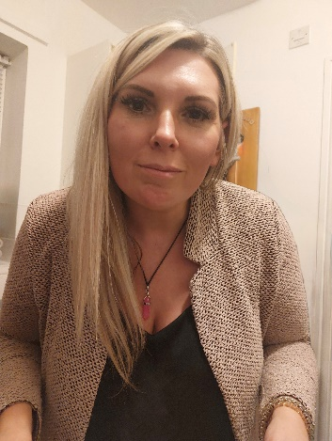
Who is who
Your children will be cared for by 3 adults in Explorers class.
Mrs Dyde is our Admin lady and Ms Hodgson is our Head teacher.
We work together to support every child's learning and development, ensuring they feel safe and happy at school. We can't wait to meet you all!
Ms Hodgson
Mrs Dyde
Mrs Osei-Konadu
Mrs Mills
Mrs Young

Slide 9

Three prime areas of learning and development
Communication and Language
Physical Development
Personal, Social and Emotional Development
Four specific areas of learning and development
Literacy
Mathematics
Understanding the World
Expressive Arts and Design
Notes:
Prime areas are a focus during first half of autumn term to enable the children to achieve in the specific areas.
If you can’t talk about it- you cant write about it
If you cant do large movements/ fine movements you cant hold a pencil
If you are worried/ anxious/ falling out with friends- not happy and secure to learn other things

Slide 10
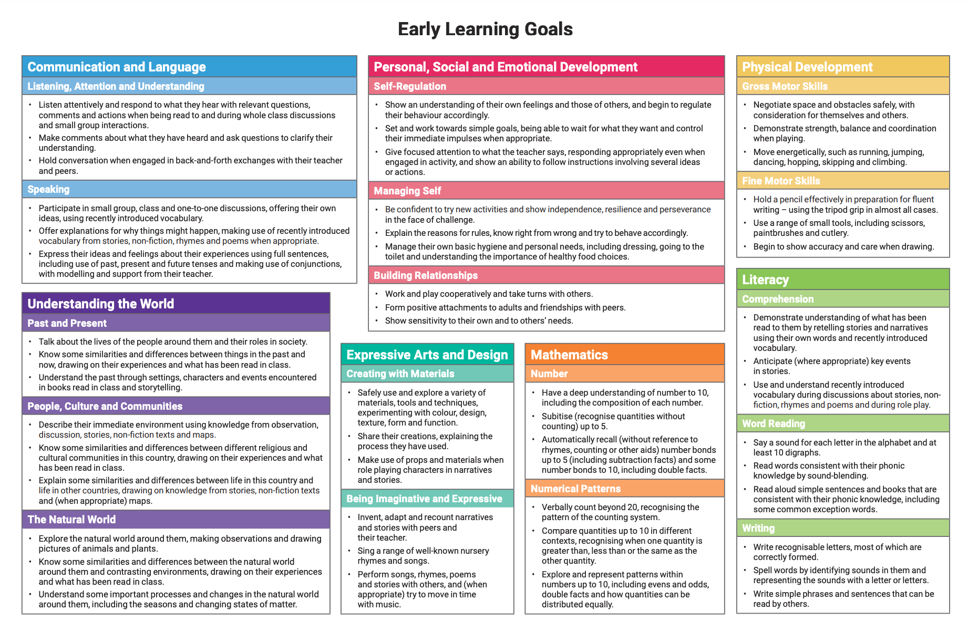
EARLY LEARNING GOALS
Children are assessed against ELGs at the end of Reception.
To achieve Good Level of Development (GLD), children should achieve ELG in Prime Areas + Literacy + Mathematics

Slide 11
The three characteristics of effective learning- how young children learn- these are taken into account when we plan and guide children’s activities.
Playing and exploring
Active learning
3 Creating and thinking critically
Notes:
Focused on how children learn. Do they come up with their own ideas/ make links in their learning/ challenge themselves/ persevere/ make predictions and test them out etc.

Slide 12
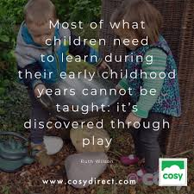


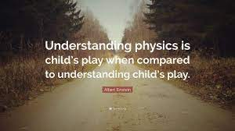
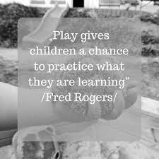
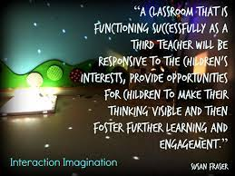
“THEY’RE JUST PLAYING……”

Slide 13

Staggered Start Option
In September, you will have the option for a staggered start to help your child settle in. This means different starting times for different groups. We want to make sure everyone feels comfortable and ready for their exciting school journey!

Slide 14
School Day
School starts at 08.45 am and finishes at 3:15pm

Slide 15
A typical morning in Reception…
8.45am Come in, hang coat up and do some morning activities.
8.55am Register and lunch choices
9.00am Worship
9.30am Phonics/ Own Learning and adult focused tasks (inside and outside)
10.30am Play time with fruit and milk (provided)
10.45am Maths/ Own Learning and adult focused tasks (inside and outside)
11.45am Get ready for lunch/ story
1200noon Lunch
Notes:
The children’s day is balanced between adult focused activities and independent learning time where the children have the choice what they do. They are encouraged to become independent learners- eg find their resources and put them away at the end.
We use both inside and outside daily.
This is also changeable throughout the year- once the children are settled we move to doing phonics first thing and have a maths slot etc

Slide 16
A typical afternoon in Reception…
13.00 Register and teacher input
13.20- 14.30 Own Learning and adult focused tasks (inside and outside)
14.45-15.00 Story time
15.00 Getting ready for home time
15.15 Home time
Reception Learning is not always clean! Please be understanding!
Notes:
Although we have aprons and will insist they are worn, children have an amazing ability to get stuff on their clothes! It should be washable such as chalk/ gloop etc.
Again this will change as the year progresses and more adult directed tasks are introduced such as PE sessions.

Slide 17
The first few weeks
We will find out what the children
already know and can do
and use this information to help us develop an individual learning programme
for each child.
We spend lots of our time working and talking to the children about what they are learning. We may record some ‘Wow’ moments formally but largely we assess and move children on ‘in the moment’ and so not everything gets recorded.
You will be invited to discuss
how your child has settled in
and their progress so far at
the parents evening.
Notes:
Not sure about what learning journeys will look like exactly this year but I have your email addresses if we do go down the Tapestry route.

Slide 18

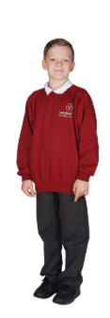

School Uniforms
At Longford, we believe in looking smart and feeling proud!

Slide 19
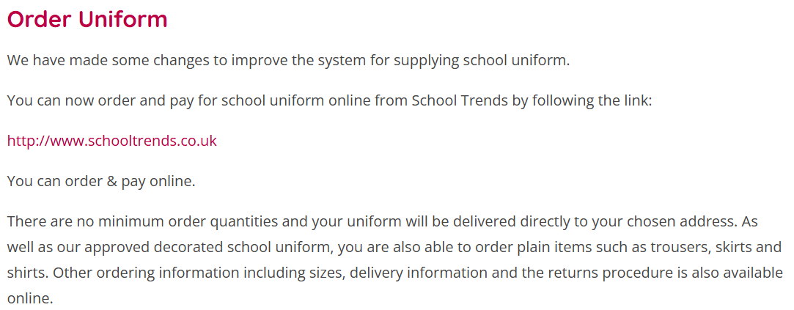
School Uniforms

Slide 20
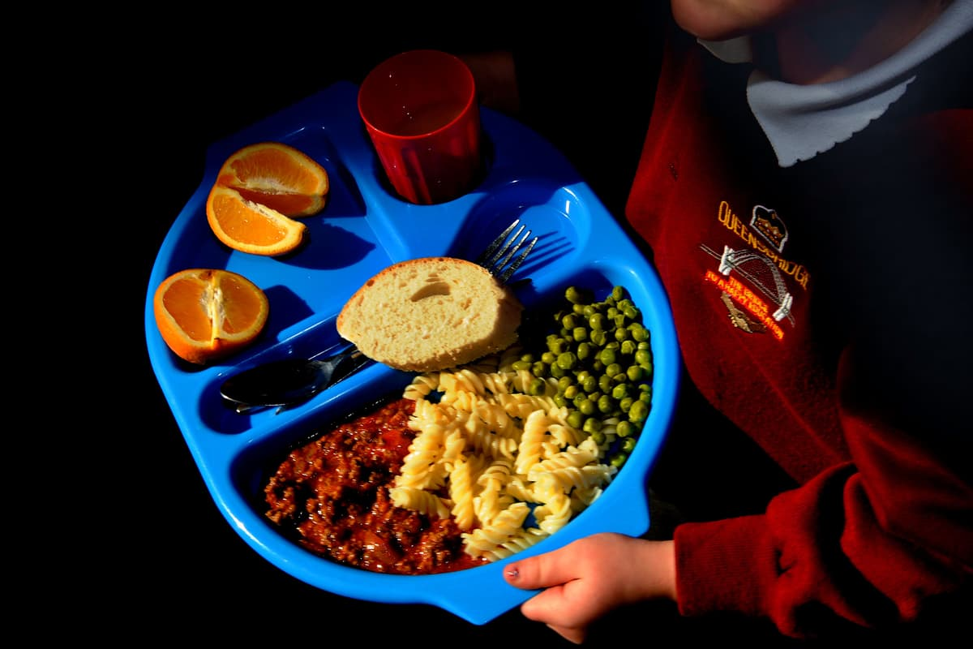
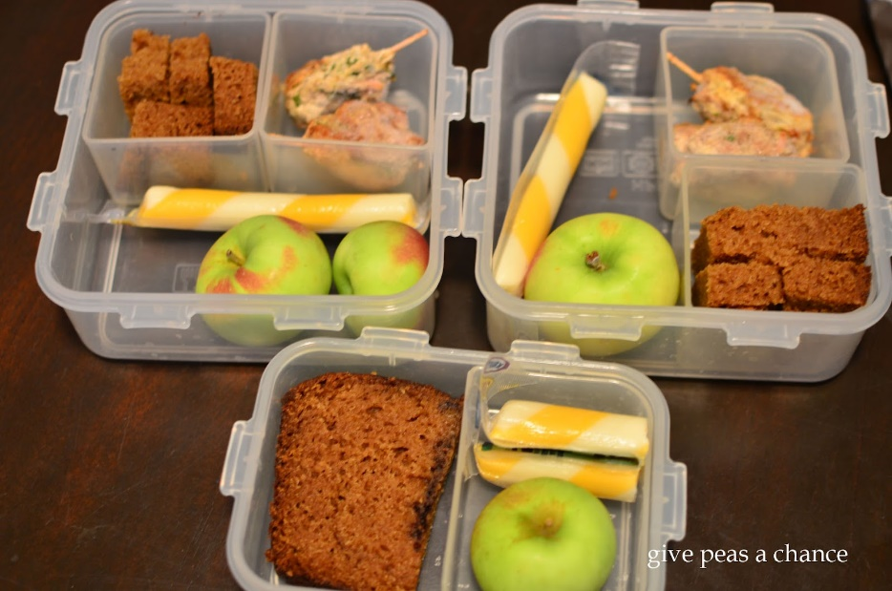
Free School Lunches
Reception children are entitled to free school lunches, which is a tasty way to enjoy healthy meals at school. If you prefer, you can also pack a lunch for your child. We want every child to eat well and be ready to learn!
<suggested search for images: "school lunch">

Slide 21
NO
PEANUTS
Or products containing peanuts to be brought into school.
No peanut butter, cereal bars with peanuts, chocolate with peanuts etc

Slide 22
Attendance
Please ensure your child is in school on time. School opens at 8:45am and registration is at 8:55am.
It is important your child is in school everyday.
If your child has any appointments please fill in one of the green forms at the office.

Slide 23

Important Paperwork
You will receive some important paperwork from our admin team. Please complete the forms, especially those about School Money our payment system and other details. It’s essential to return them quickly so we can sort everything for your child's start at school!

Slide 24
Medical Matters
Any sickness, diarrhoea, must be followed by 48 hours absence.
Any absence requires a note or telephone call explaining why.
Head lice are common! Please check regularly and treat as recommended.
Any medicines can only be administered by prior arrangement

Slide 25
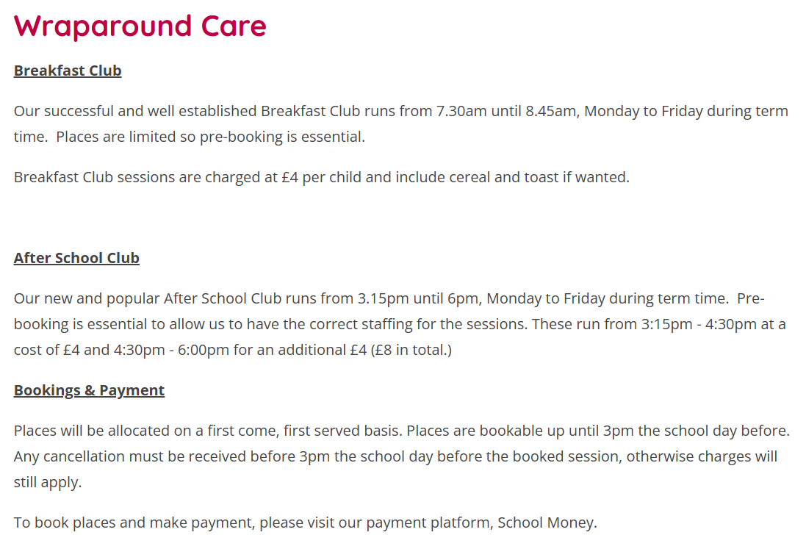
Wrap Around Care
We offer ‘wrap around care’ for our families. This means that you can have extra time at school before and after lessons. It’s a great opportunity to play and learn in a safe environment until parents or guardians can pick you up!
<suggested search for images: "school wrap around care">

Slide 26
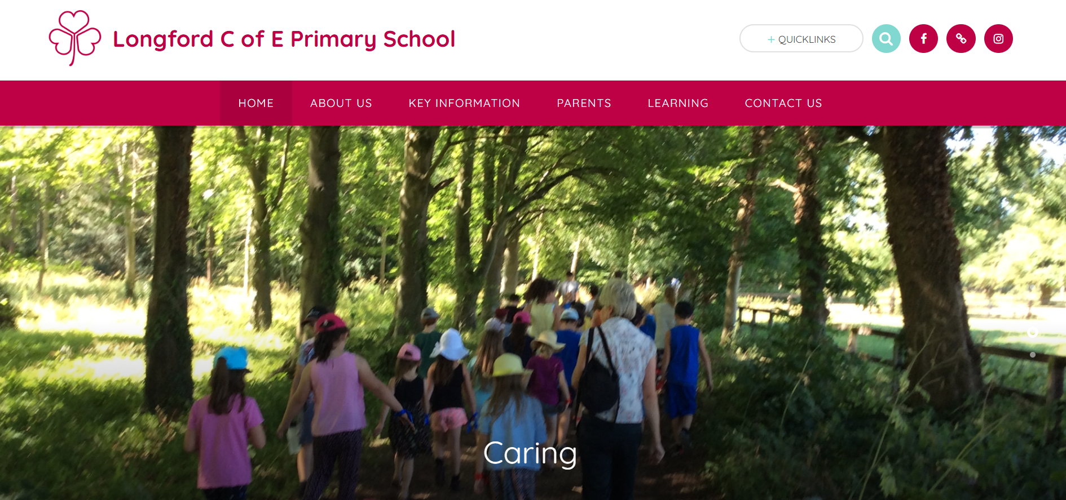
Our School’s website
Don’t forget to visit our school’s website for important updates and information.

Slide 27
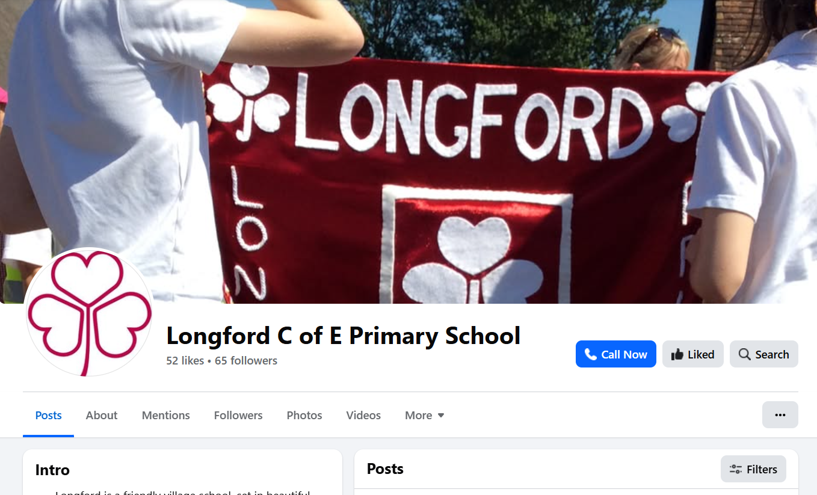
Stay Connected!
To keep up with school events, please follow us on Facebook at Longford C of E Primary School. We post reminders and exciting news. It’s a great way to stay informed and be part of our school community!

Slide 28
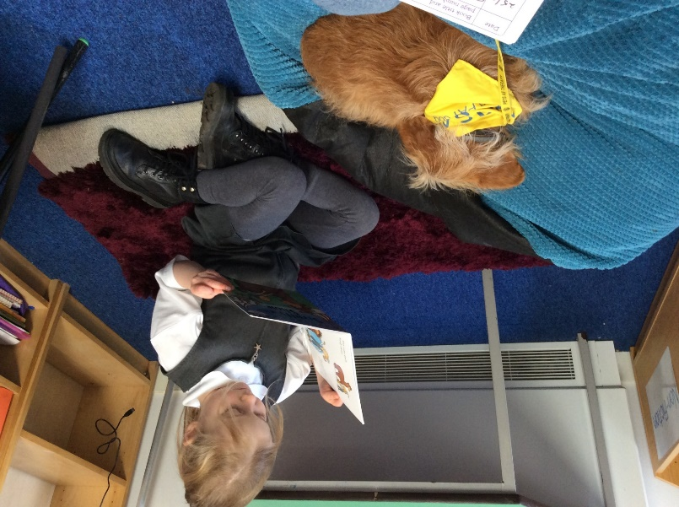
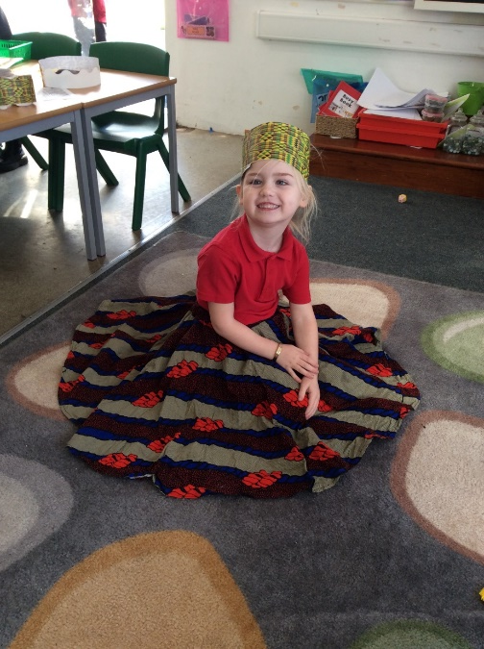
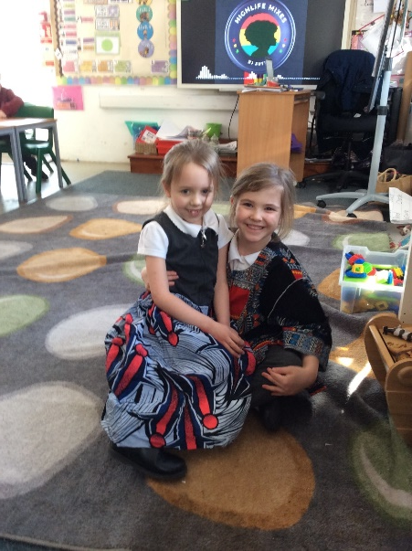
Exciting Times Ahead!
We are so excited for the school year ahead! At Longford Church of England Primary School, we are a big family. Together, we will learn new things, make friends, and create wonderful memories. Let’s make this year the best one yet!
<suggested search for images: "happy school children">

Slide 29
And Finally…
If you have any worries or concerns please come in and see us and we will do our best to help you ☺
Thank you for coming.
Notes:
Either unmute or write it in the chat ☺

Slide 30

Questions

